Slide 1
AI-Powered Smart Health Assistant
Developed By:
AUIC-22FL-BSCS-
Supervised By:
Dr.Sadaf Tanvir
Program:
Computer Science
Session:
Fall 2022 to Spring 2026
Department of Computing

Slide 2
Contents
Introduction
Methodology
Tools and Technologies
UML Diagrams
Prototype Screenshots

Slide 3
Introduction
AI-Powered Smart Health Assistant that combines all important features in one app.
Reminders, record storage, AI chatbot, caregiver updates and emergency alerts.

Slide 4
Methodology
Modules:Smart Health Agent,Health Records Manager,Caregiver Alert System,Medication Reminder System,Data Security & Privacy,AI Integration
The system will follow an MVVM (Model-View-ViewModel) architecture:
Model: Manages health records, medication data, and chatbot interactions.
• View: User interface for chatbot, reminders, logs, and alerts.
• ViewModel: Connects logic and UI, handles real-time updates.
4

Slide 5
Tools and Technologies
Technologies:
• Kotlin (Android Studio) for app development.
• Firebase for authentication, database, storage, and notifications.
• Gemini AI for chatbot functionality.
• Google Calendar API for medication reminders.
• StateFlow/LiveData for UI state management.

Slide 6
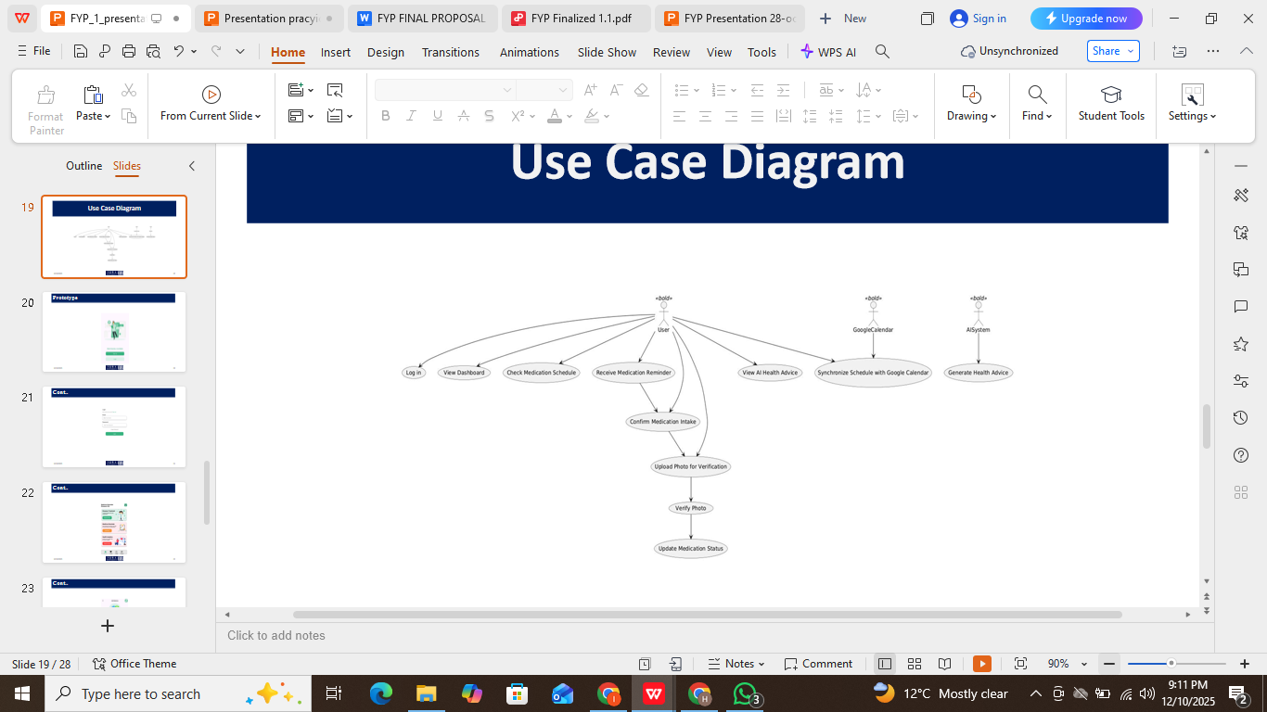
Use Case Diagram

Slide 7
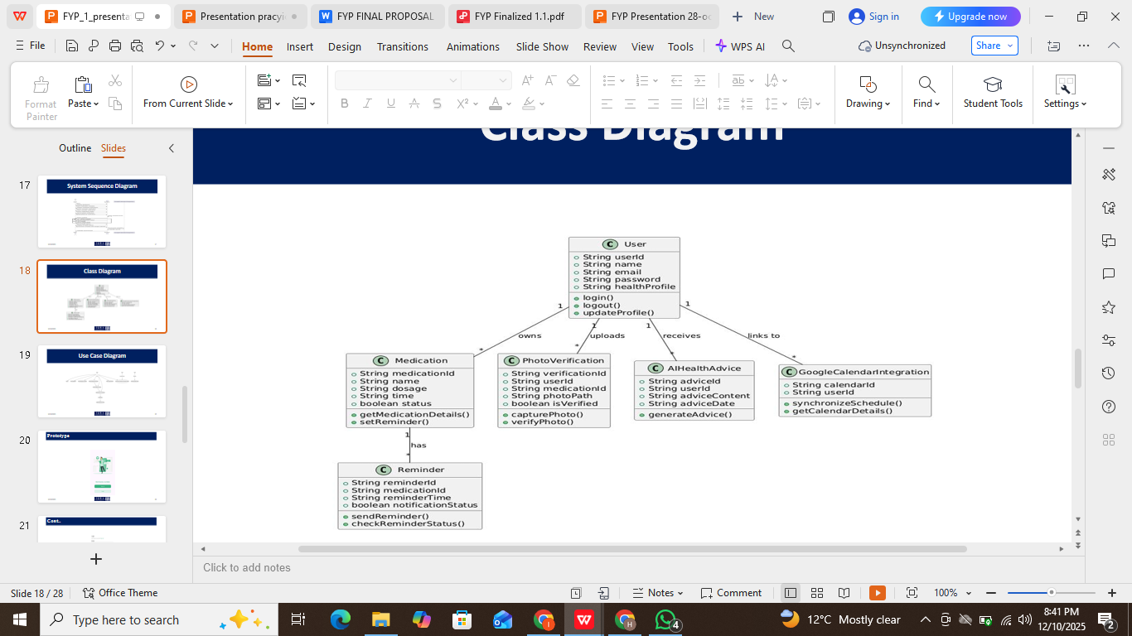
1
Class Diagram
1
1
1
1

Slide 8
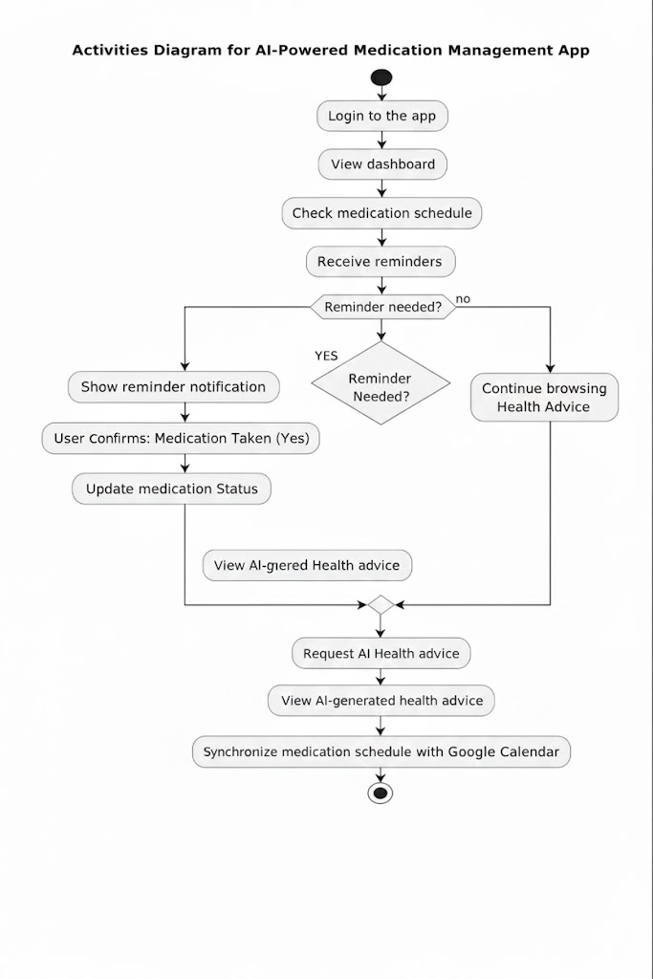
Activity Diagram

Slide 9
Questions?
And
Thank You

